Slide 1
Predicting Stock Market Trend
…
Vishwa G V

Slide 2
ABSTRACT
In the finance world, stock trading is one of the most important activities.
Stock market prediction is an act of trying to determine the future value of a stock other financial instrument traded on a financial exchange.
The technical and fundamental or the time series analysis is used by the most of the stockbrokers while making the stock predictions.
In this project we propose a Machine Learning (ML) approach that will be trained from the available stocks data and gain intelligence and then use the acquired knowledge for an accurate prediction.
This project seeks to utilize Deep Learning models, Long-Short Term Memory (LSTM) Neural Network algorithm, to predict stock prices.
For data with time frames recurrent neural networks (RNNs) come in handy but recent researches have shown that LSTM networks are the most popular and useful variants of RNNs.

Slide 3
INTRODUCTION
The stock market is an interesting medium to earn and invest money. It is also a lucrative option that increases your greed and leads to drastic decisions. This is majorly due to the volatile nature of the market. It is a gamble that can often lead to a profit or a loss. There is no proper prediction model for stock prices. The price movement is highly influenced by the demand and supply ratio
The concept behind how the stock market works is pretty simple. Operating much like an auction house, the stock market enables buyers and sellers to negotiate prices and make trades.
The task of stock prediction has always been a challenging problem for statistics experts and finance. The main reason behind this prediction is buying stocks that are likely to increase in price and then selling stocks that are probably to fall.
Generally, there are two ways for stock market prediction. Fundamental analysis is one of them and relies on a company’s technique and fundamental information like market position, expenses and annual growth rates. The second one is the technical analysis method, which concentrates on previous stock prices and values. This analysis uses historical charts and patterns to predict future prices.

Slide 4
INTRODUCTION (CONTD.)
Stock markets were normally predicted by financial experts in the past. However, data scientists have started solving prediction problems with the progress of learning techniques.
Also, computer scientists have begun using machine learning methods to improve the performance of prediction models and enhance the accuracy of predictions.
Employing deep learning was the next phase in improving prediction models with better performance. Stock market prediction is full of challenges, and data scientists usually confront some problems when they try to develop a predictive model.
Complexity and nonlinearity are two main challenges caused by the instability of the stock market and the correlation between investment psychology and market behavior.

Slide 5
INTRODUCTION (CONTD.)
It is clear that there are always unpredictable factors such as the public image of companies or the political situation of countries, which affect stock markets trends.
Therefore, if the data gained from stock values are efficiently preprocessed and suitable algorithms are employed, the trend of stock values and index can be predicted.
In stock market prediction systems, machine learning and deep learning approaches can help investors and traders through their decisions. These methods intend to automatically recognize and learn patterns among big amounts of information.
The algorithms can be effectively self-learning, and can tackle the predicting task of price fluctuations in order to improve trading strategies.

Slide 6
PROBLEM STATEMENT
The stock market appears in the news every day. You hear about it every time it reaches a new high or a new low.
The rate of investment and business opportunities in the Stock market can increase if an efficient algorithm could be devised to predict the short term price of an individual stock.
Previous methods of stock predictions involve the use of Artificial Neural Networks and Convolution Neural Networks which have an error loss at an average of 20%.
In this project, we will see if there is a possibility of devising a model using Recurrent Neural Network (LSTM) which will predict stock price with a less percentage of error..

Slide 7
INNOVATION
❖ Our base paper describes only using different learning algorithms for predicting the trend of the stock market.
❖ But, we have chosen LSTM and trained the model efficiently to predict the trend.
❖ Our contribution for the project is that we have included risk analysis as an innovation.
❖ In risk analysis we use “Monte carlo method “and “bootstrap method” to find the “Value at risk”.

Slide 8
LITERATURE SURVEY
S.No | Paper | Author | Publication | Methodology
1. | Stock market trading rule discovery using two-layer bias decision tree | Wang, J.Wang, J.L., Chan, S.H.L., Chan, S.H. | IEEE,2006 | Applied the concept of serial topology and designed a new decision system, namely the two layer bias decision tree, for stock price prediction

Slide 9
LITERATURE SURVEY(CONTD.)
S.No | Paper | Author | Publication | Methodology
2. | Indian Stock Market Prediction Using Machine Learning and Sentiment Analysis | Nisha Shetty, Ashish Pathak | Research gate publication, Dec 2017 | This research aims to combine multiple existing techniques into a much more robust prediction model which can handle various scenarios in which investment can be beneficial. Existing techniques like sentiment analysis or neural network techniques can be too narrow in their approach and can lead to erroneous outcomes for varying scenarios. By combing both techniques, this prediction model can provide more accurate and flexible recommendations. Embedding Technical indicators will guide the investor to minimize the risk and reap better returns

Slide 10
LITERATURE SURVEY(CONTD.)
S.No | Paper | Author | Publication | Methodology
3. | Analysing Stock Market Trend Prediction using Machine & Deep Learning Models: A Comprehensive Review | i)Doan Yen Nhi LeStudy Group, Australia ii)Angelika MaagStudy Group, Australia iii)Suntharalingam Senthilananthan Charles Sturt University, Australia | IEEE (2020 5th International Conference on Innovative Technologies in Intelligent Systems and Industrial Applications (CITISIA)) | This paper aims to provide a comprehensive review of the exiting researches which related to the application of Machine Learning and Deep Learning models in financial market forecasting domain. To prepare for this project, more than sixty research papers were analysed in-depth to extract required quantitative information, applications, and results on different methodologies. It is found from this project that Deep Learning outperformed Machine Learning in all the collected research papers, and it is the most suitable methodologies to apply to the stock market forecasting domain

Slide 11
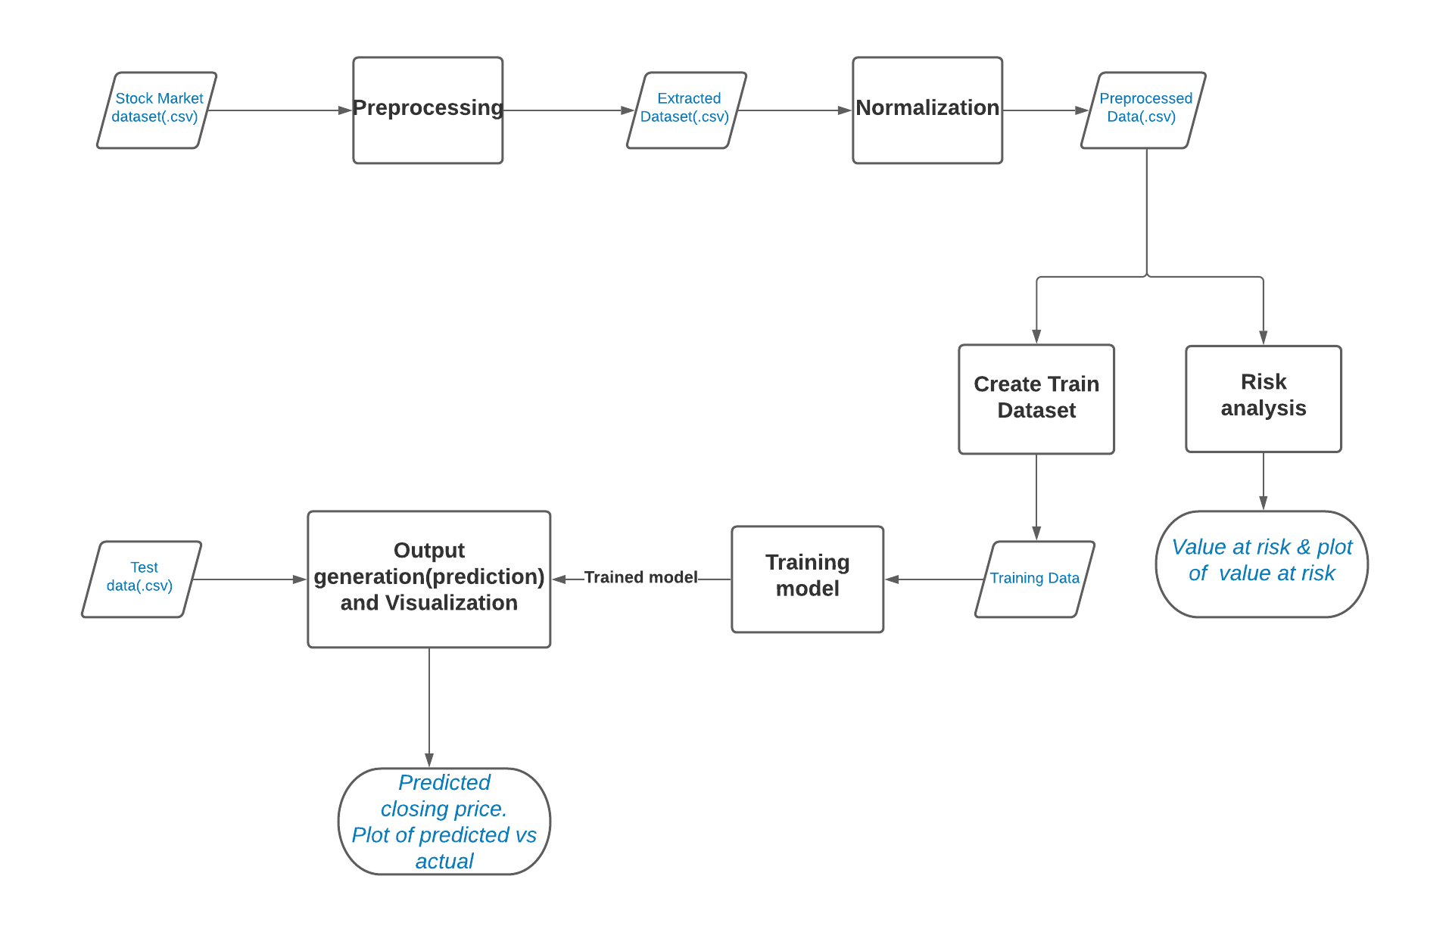
BLOCK DIAGRAM

Slide 12
DETAILS OF THE MODULES

Slide 13
MODULE 1 : PREPROCESSING
Input: Stock market dataset is given as input in csv format(stockData.csv)
Output: Stock market dataset with selected attributes (columns) -(extractedStockData.csv)
Explanation:
The data set stockData.csv contains attributes such as date, open, high, low, close, volume.
Open: It is the price at which the financial security opens in the market when trading begins. It may or may not be different from the previous day's closing price.
High: Today's high refers to a security's intraday high trading price or the highest price at which a stock traded during the course of the day.
Low: Today's low is a security's intraday low trading price. Today's low is the lowest price at which a stock trades over the course of a trading day.
Close: The final price at which the stock was traded before the market closed for the day.
Volume: Volume is the amount of an asset or Security that changes hands over some period of time, often over the course of a day. For instance, stock trading volume would refer to the number of shares of a security traded between its daily open and close.
The extracted dataset contains only six attributes namely date, open, high, low, close, volume. Close attribute is the label and the open, close variable are the weights.

Slide 14
MODULE 2 : NORMALIZATION
Input: Stock market dataset with selected attributes (columns) -(extractedStockData.csv)
Output: Pre-processed stock dataset (preprocessedData.csv)
Explanation:
Normalization is a technique often applied as part of data preparation for machine learning.
The goal of normalization is to change the values of numeric columns in the dataset to use a common scale, without distorting differences in the ranges of values or losing information.
In this module we use MinMaxScalar to normalize the data.

Slide 15
MODULE 3 : TRAINING THE LSTM MODEL
Input: Pre-processed stock dataset (preprocessedData.csv)
Output: Trained model
Explanation:
In this module we create a data structure with ‘n’ timesteps and 1 output. For example: If the timesteps is equal to 60, then the first 60 days is used to predict the closing value of 61st day, and data of day2 to day61 is used to predict the closing value of 62nd day.
In this model the train data is fed into the model and trained for prediction assigning random biases and weights.
Optimizer: The type of optimizer used can greatly affect how fast the algorithm coverages to the minimum value. Here we have chosen to use Adam optimizer.
The Adam Optimizer combines the perks of two other optimizers: ADAgrad and RMSprop. Adam (Adaptive Movement Estimation) computes adaptive learning rates for each parameter based on its past gradients.

Slide 16





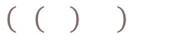


MODULE 3 (CONTD.)
where
Regularization: Another important aspect of training the model is making sure the weights do not get too large, hence. overfit. For this purpose, we have chosen to use Tikhonov regularization.
The minimization problem is given by:
Dropouts: Dropouts are used in making the neurons more robust and hence allowing them to predict the trend without focusing on any one neuron.

Slide 17
MODULE 4 :OUTPUT GENERATION AND VISUALIZATION
Input: Test dataset
Output: Predicted closing values of the stock and a plot of the predicted values and actual value.
Explanation:
A rolling analysis of time series models is often used to assess the model’s stability over time.
When analysing financial time series data using statistical models, a key assumption is that the parameters of the model are constant over time.
Once the model predicts the value of close price for unseen data (test data), then a plot is constructed using matplot.

Slide 18
MODULE 5 :RISK ANALYSIS
Input: Pre-processed stock dataset (preprocessedData.csv)
Output: Value at risk and plot of value at risk (risk vs expected return)
Explanation:
There are many ways we can quantify risk, one of the most basic ways using the information we've gathered on daily percentage returns is by comparing the expected return with the standard deviation of the daily returns (Risk).
Daily Returns: A return, also known as a financial return, in its simplest terms, is the money made or lost on an investment over some period of time.
A return can be expressed nominally as the change in dollar value of an investment over time. A return can also be expressed as a percentage derived from the ratio of profit to investment.
Daily return is computed and histogram and few are plots are plotted.

Slide 19
MODULE 5 (CONTD)
Value at risk: Now we move ahead and define a value at risk parameter for our stocks.
We can treat value at risk as the amount of money we could expect to lose (aka putting at risk) for a given confidence interval.
There’s several methods we can use for estimating a value at risk.
We compute and plot:
5.1 Value at Risk using the Monte Carlo method
5.2 Value at risk using the "bootstrap" method

Slide 20
SCREENSHOTS OF MODULES

Slide 21
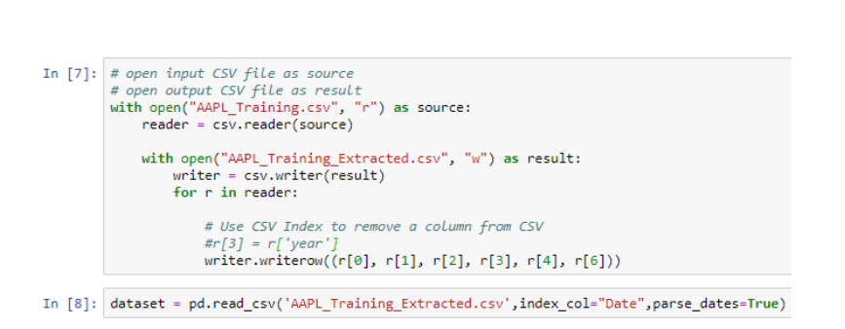
MODULE 1
Code:

Slide 22
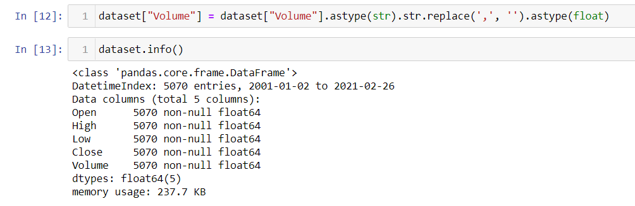
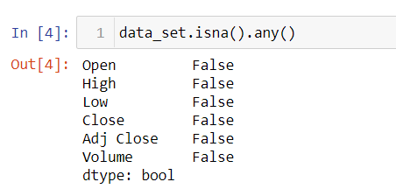
MODULE 1(CONTD)

Slide 23
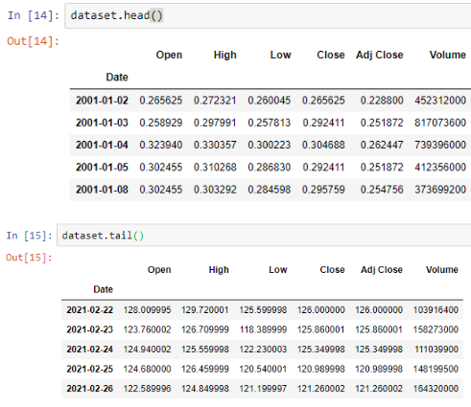
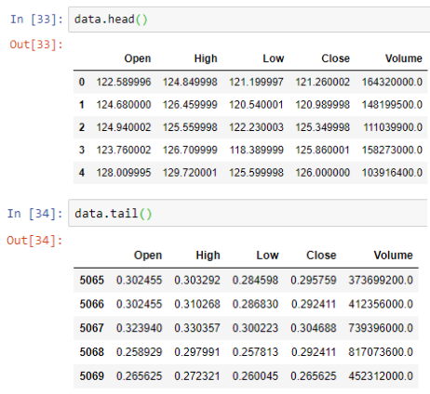
MODULE 1
Input: Output:

Slide 24
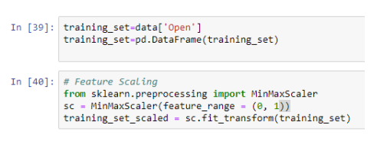
MODULE 2
Code:

Slide 25
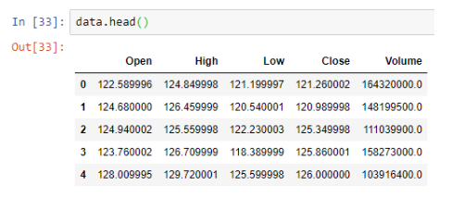
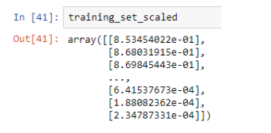
MODULE 2
Input: Output:

Slide 26
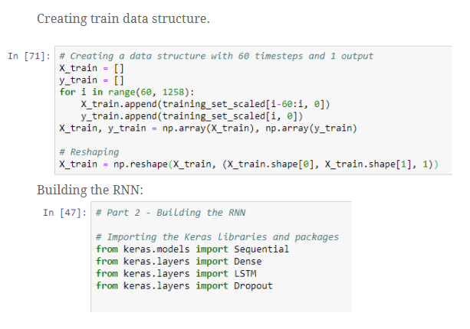
MODULE 3
Code:

Slide 27
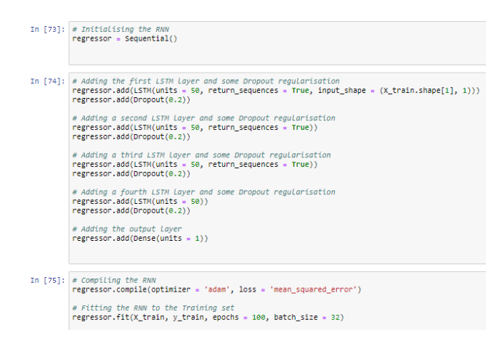
MODULE 3(CONTD.)

Slide 28
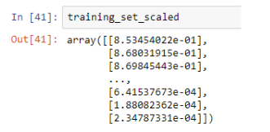
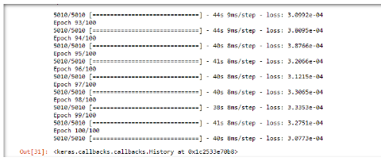
MODULE 3
Input: Output:

Slide 29
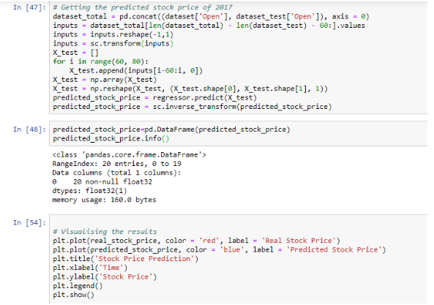
MODULE 4
Code:

Slide 30
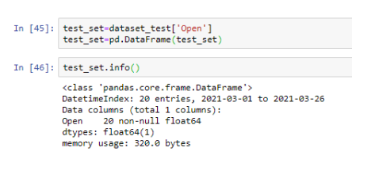
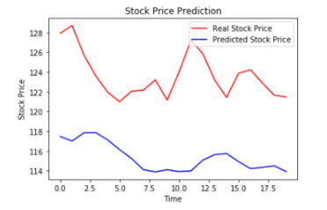
MODULE 4
Input: Output:

Slide 31
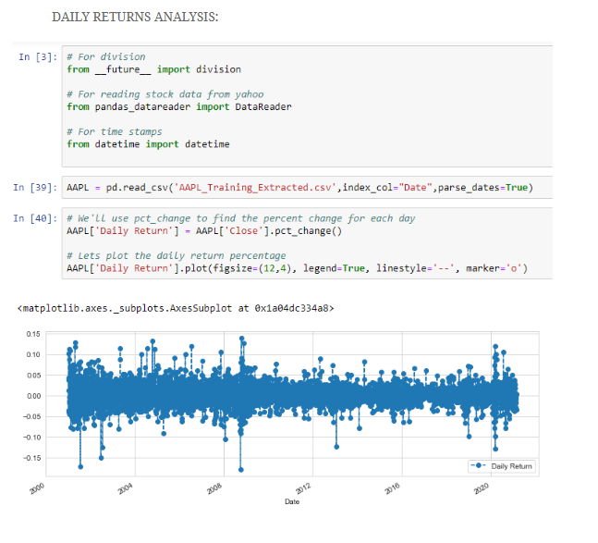
MODULE 5.1
Code:

Slide 32
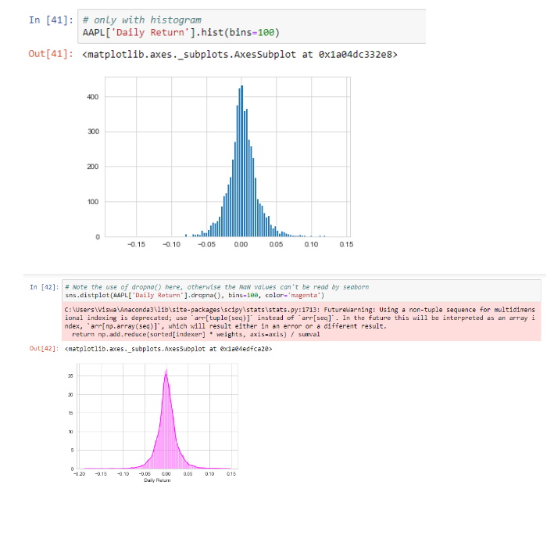
MODULE 5.1

Slide 33
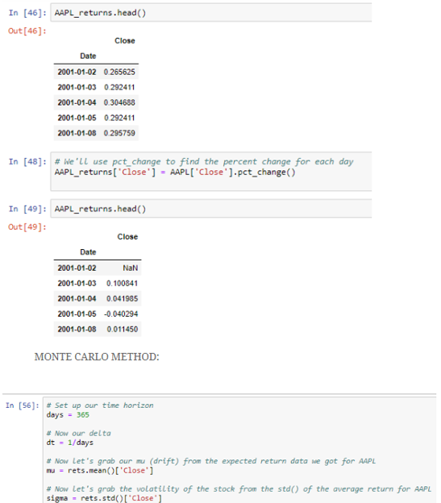
MODULE 5.1

Slide 34
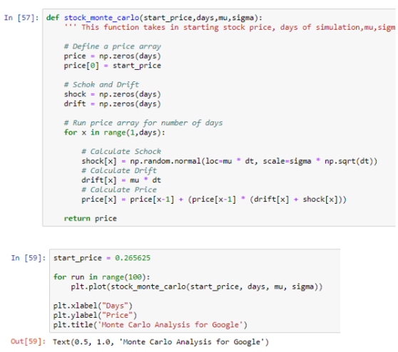
MODULE 5.1

Slide 35
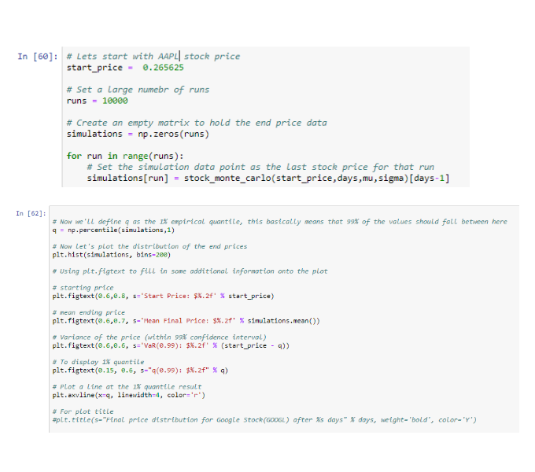
MODULE 5.1

Slide 36
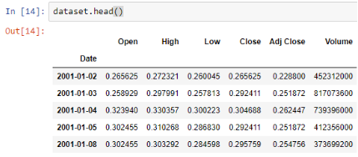
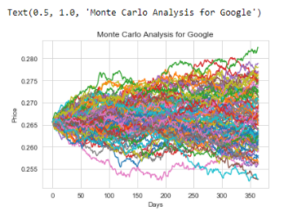
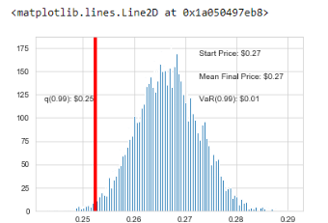
MODULE 5.1
Input: Output:
Now we have looked at the 1% empirical quantile of the final price distribution to estimate the Value at Risk for the Google Stock(AAPL),which looks to be $0.01 for every investment of $0.27(The price of one initial Apple stock)., i.e., if we invest 1milliondollars put 37,037 dollars at risk.
This basically means for every initial AAPL stock you purchase you’re putting about $0.01 at risk 99% of the time from our Monte Carlo Simulation.

Slide 37
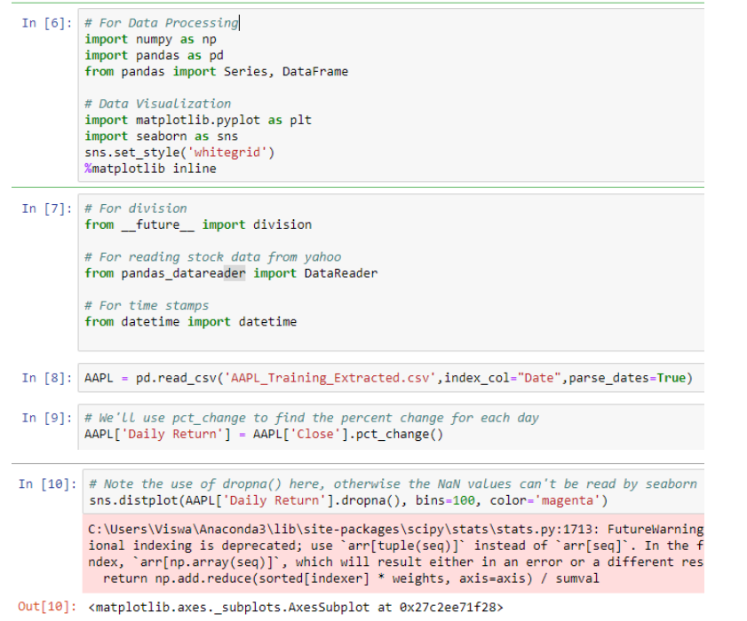
MODULE 5.2
Code:

Slide 38
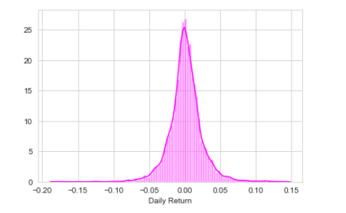
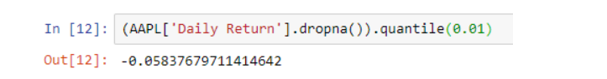
MODULE 5.2
Input: Output:
In statistics and probability, quantiles are cut points dividing the range of a probability distribution into continuous intervals with equal probabilities, or dividing the observations in a sample in the same way.
The 0.01 empirical quantile of AAPL stock daily returns is at -0.05. That means that with 99% confidence, our worst daily loss will not exceed5%. If we have a 1 million dollar investment, our one-day 1% VaR is 0.05 * 1,000,000 = $50,000.

Slide 39
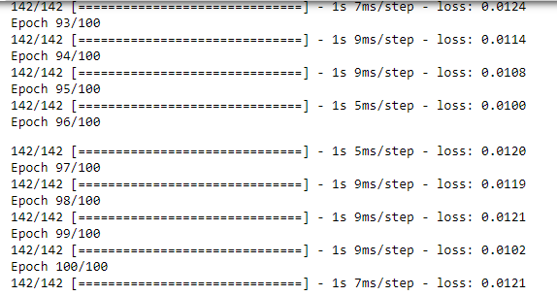
EVALUATION METRICS & ACCURACY
The error loss percentage (RMS error) is computed during compilation of the model:
The error loss percentage in the final epoch of training is 0.0121.

Slide 40
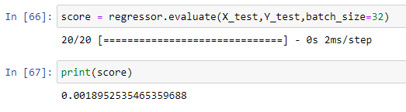
EVALUATION METRICS (CONTD)
The error loss percentage (RMS error) for the testing dataset (unseen dataset) is given in the following image:
The error loss for the test dataset is 0.0018. Therefore, the model produces less error.

Slide 41
MODULES AND DELIVERABLES
Modules | Input | Output
Module-1 | Stock market dataset | Dataset with selected attributes
Module-2 | Dataset with selected attributes | Pre-processed stock data
Module-3 | Pre-processed stock data | Trained model
Module-4 | Test data | Predicted closing value of stock, plot-actual & predicted
Module-5 | Pre-processed stock data | Value at risk & plot-risk vs expected return

Slide 42
REFERENCES
Andrew McCallum, Kamal Nigam, Jason Rennie, Kristie Seymore “A Machine learning approach to Building domain-specific Search engine”, IJCAI, 1999 – Citeseer
Yadav, Sameer. (2017). STOCK MARKET VOLATILITY - ASTUDY OF INDIAN STOCK MARKET. Global Journal for Research Analysis. 6. 629-632.
Montgomery, D.C., Peck, E.A. and Vining, G.G., 2012. Introduction to linear regression analysis (Vol. 821). John Wiley & Sons.
Draper, N.R.; Smith, H. (1998). Applied Regression Analysis (3rded.). John Wiley. ISBN 0-471-17082-8.
Robert S. Pindyck and Daniel L. Rubinfeld (1998, 4h ed.).Econometric Models and Economic Forecasts
“Linear Regression”, 1997-1998, Yale University http://www.stat.yale.edu/Courses/1997-98/101/linreg.htm

Slide 43
REFERENCES(CONTD.)
Agarwal (July 14, 2017). "Introduction to the Stock Market". Intelligent Economist. Retrieved December 18, 2017.
Jason Brownlee, March 2016, “Linear Regression for machine learning”, Machine learning mastery, viewed on December 2018, https://machinelearningmastery.com/linear-regression-for-machinelearning/
Google Developers, Oct 2018, “Descending into ML: Linear Regression”, Google LLC, https://developers.google.com/machinelearning/crash-course/descending-into-ml/linear-regression
Fiess, N.M. and MacDonald, R., 2002. Towards the fundamentals of technical analysis: analysing the information content of High, Low and Close prices. Economic Modelling, 19(3), pp.353-374.
Hurwitz, E. and Marwala, T., 2012. Common mistakes when applying computational intelligence and machine learning to stock market modelling. arXiv preprint arXiv:1208.4429.

